Slide 1


IndiGro: Predict. Prevent. Prosper.
Submitted By :
Japneet Kaur 2210990433
Japneet Singh 2210990434
Jasneet Arora 2210990451
Supervised By:
Ms. Shagun Sharma

Slide 2

Table of Contents
Problem Statement
Introduction
Technical Details
Key Features
Benefits
Dashboard Snapshots
Explore Our Project
References

Slide 3
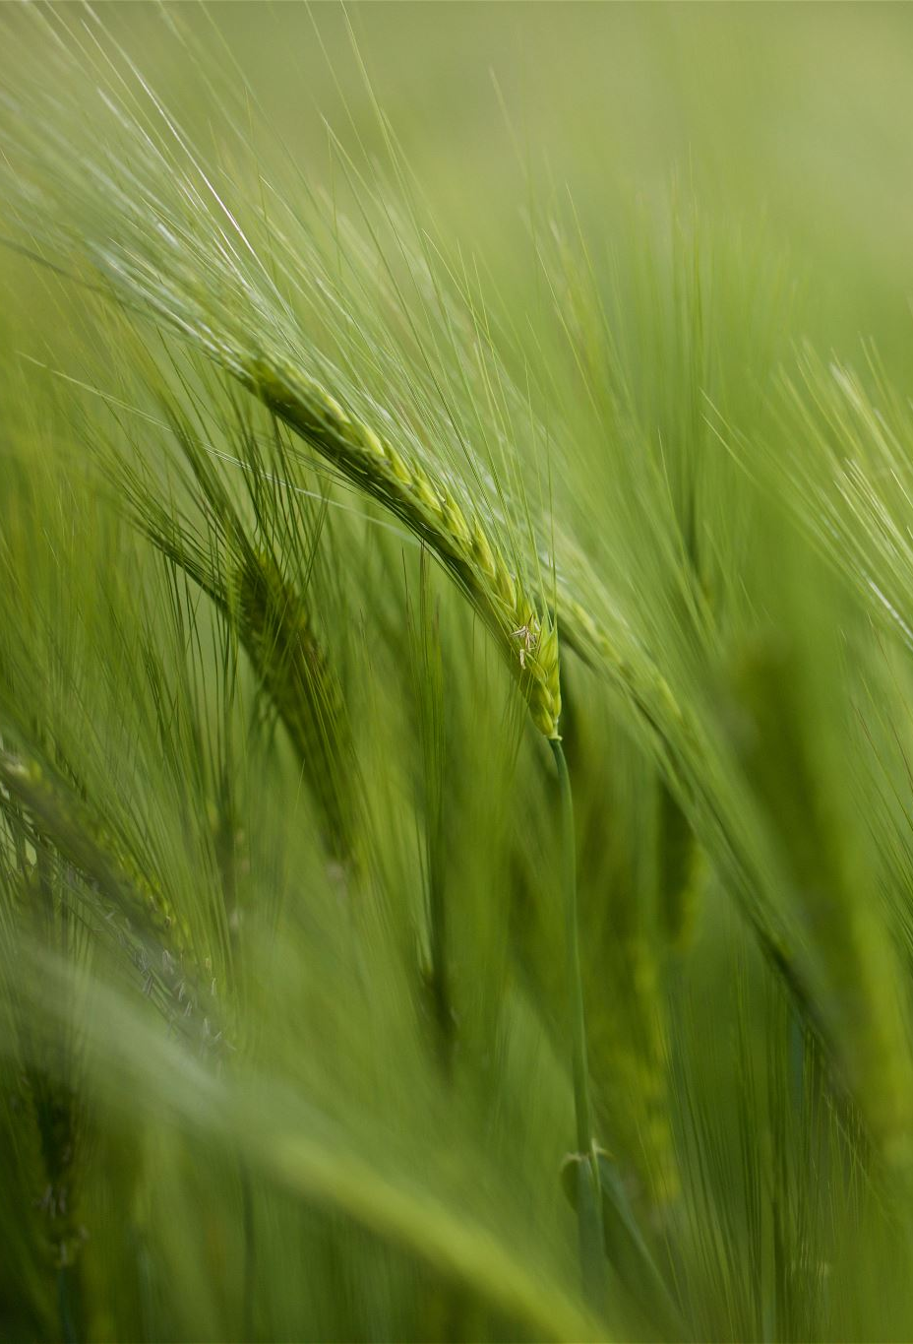
Problem Statement
Losses Mount: Significant crop losses plague farmers due to plant diseases.
Slow and Costly Diagnosis: Traditional methods like lab testing are:
Slow: Results take a long time, delaying treatment.
Expensive: Lab fees strain farmer budgets.
Consequences of Delays:
Increased disease spread and crop damage.
Reduced yields and lower profits for farmers.
Potential food shortages.

Slide 4
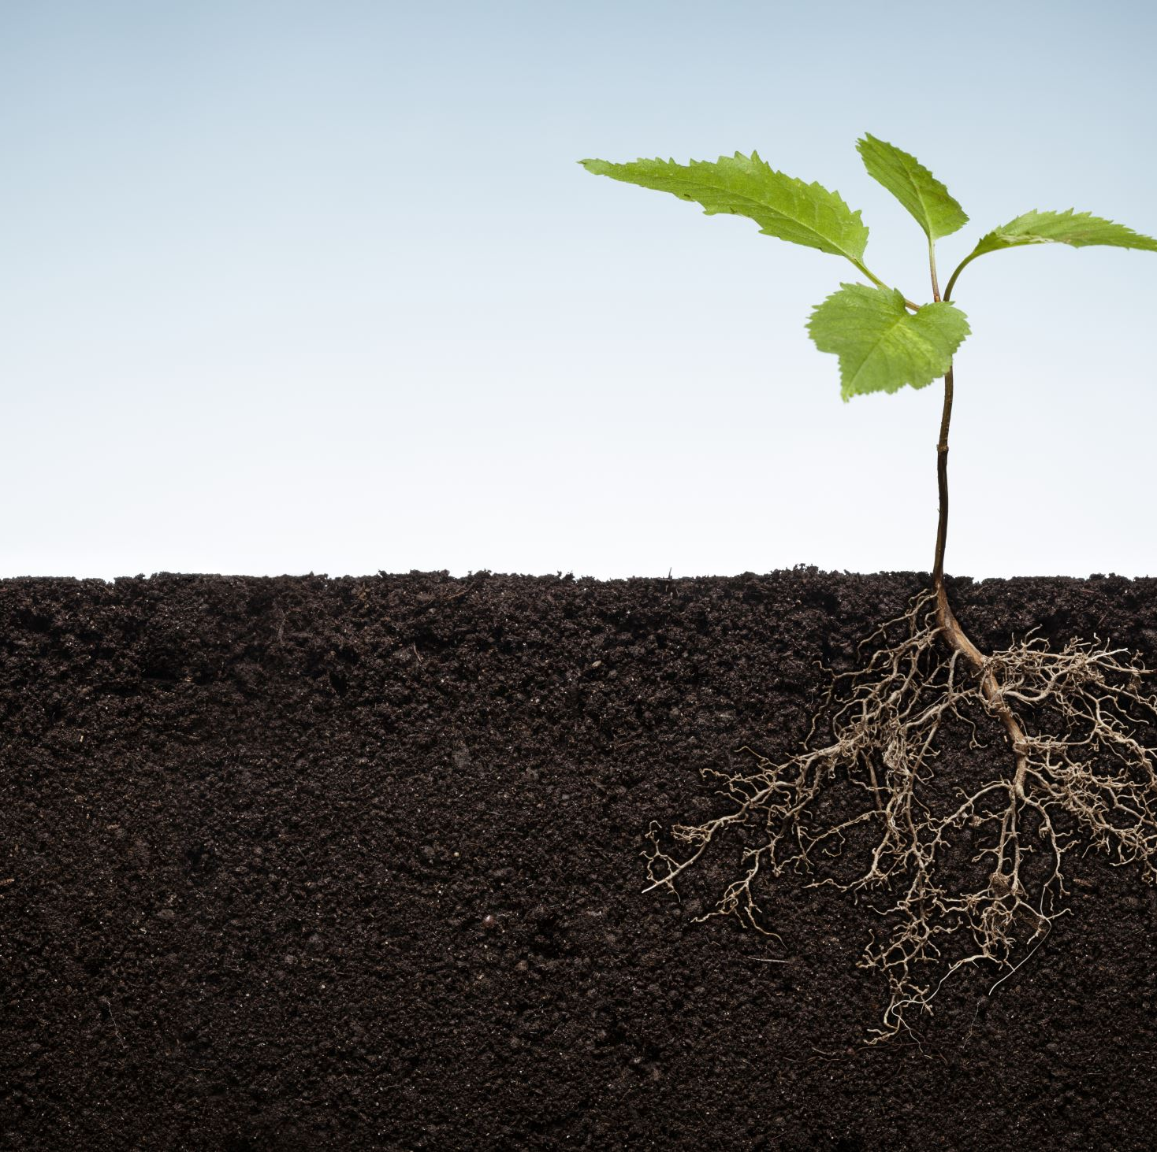
Introduction
Effortless Disease Diagnosis:
Our AI-powered solution leverages deep learning to diagnose plant diseases directly on farms.
User-Friendly Web App:
Simply upload pictures of your crops for instant analysis.
Real-time Results with Chatbot Support:
Receive disease identification.
Gain real-time insights into the problem.
Access targeted treatment recommendations through our chatbot assistant.

Slide 5

Technical Details
Python
NumPy
Pandas
Matplotlib
Seaborn
Scikit Learn
TensorFlow
Keras
OpenCV
Streamlit

Slide 6
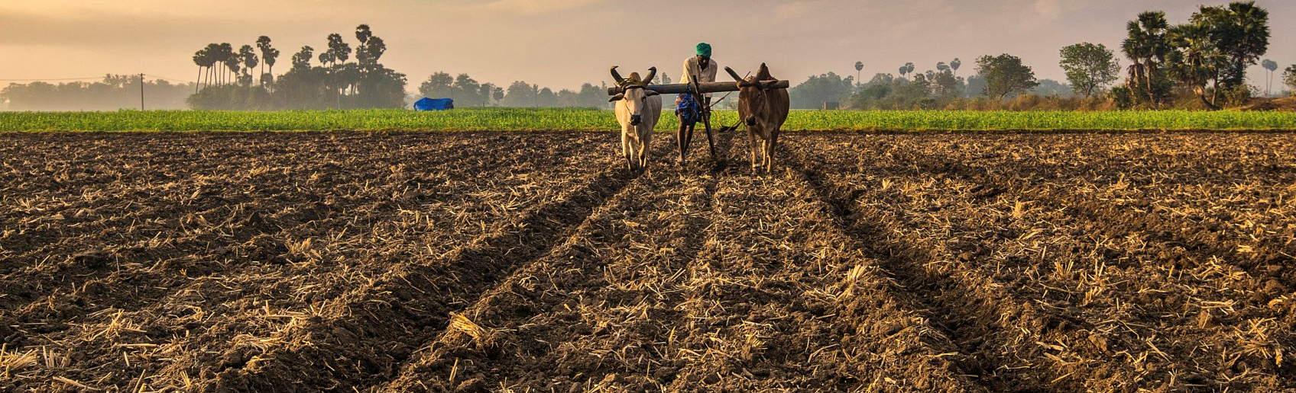
Key Features
AI Analysis: Our AI model, trained on extensive data, provides instant disease diagnosis, allowing you to act swiftly to protect your crops.
Chatbot: The chatbot provides natural language interaction for plant disease diagnosis, personalized advice, and access to plant care knowledge.
Streamlined User Interface: The user-friendly interface of the web application minimizes complexity and facilitates efficient navigation, empowering farmers to quickly leverage the platform's capabilities.

Slide 7
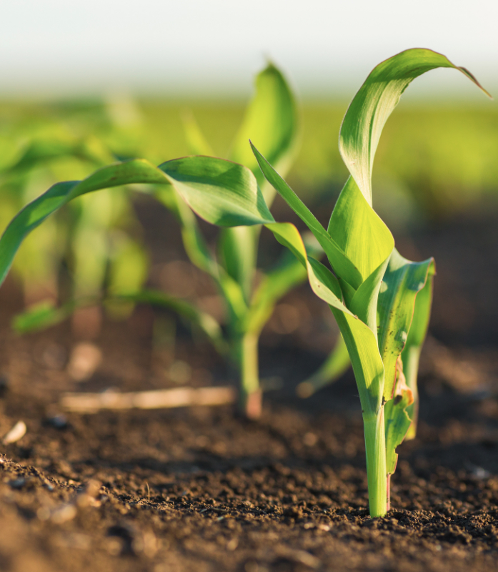
Benefits
1. Swift Diagnosis: Our AI-powered system swiftly identifies diseases, enabling prompt action to safeguard your crops.
2. Unrivaled Accuracy: Backed by extensive datasets, our model ensures precise detection of plant diseases.
3. Cost-effective: Save valuable time and resources with our efficient approach compared to traditional lab testing.
4. Empowering Farmers: We equip farmers with advanced technology, empowering them to make informed decisions and enhance their farm management practices.

Slide 8
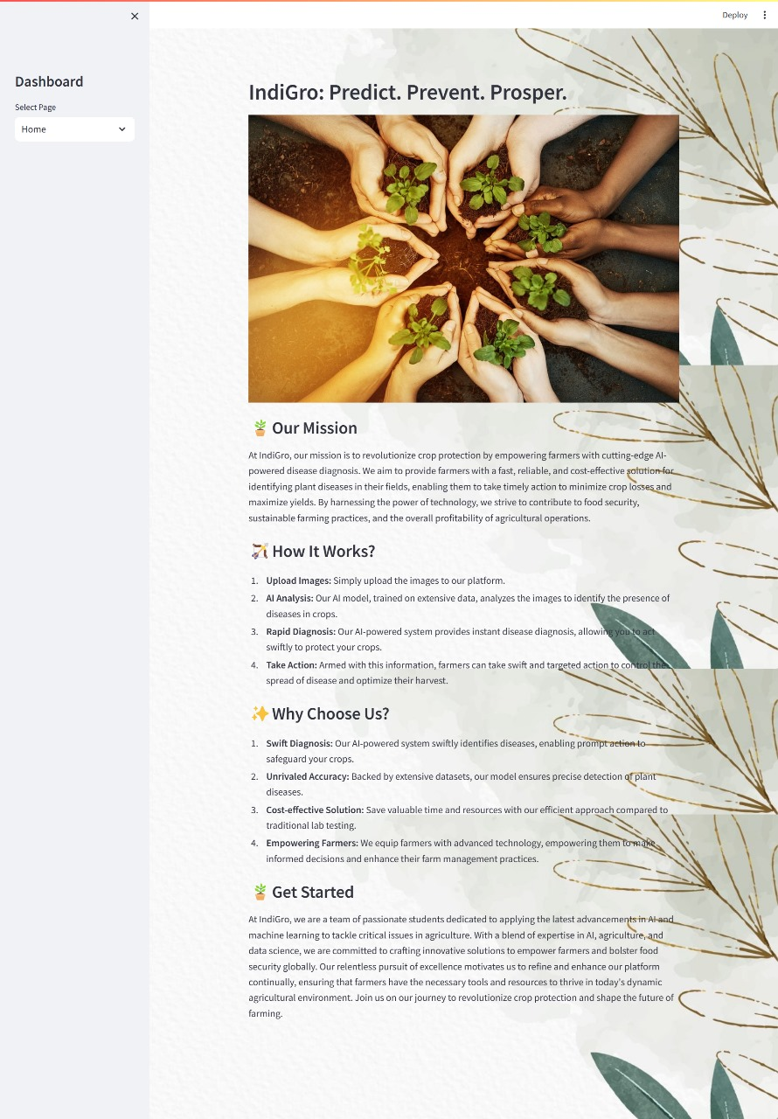
Dashboard Snapshots

Slide 9
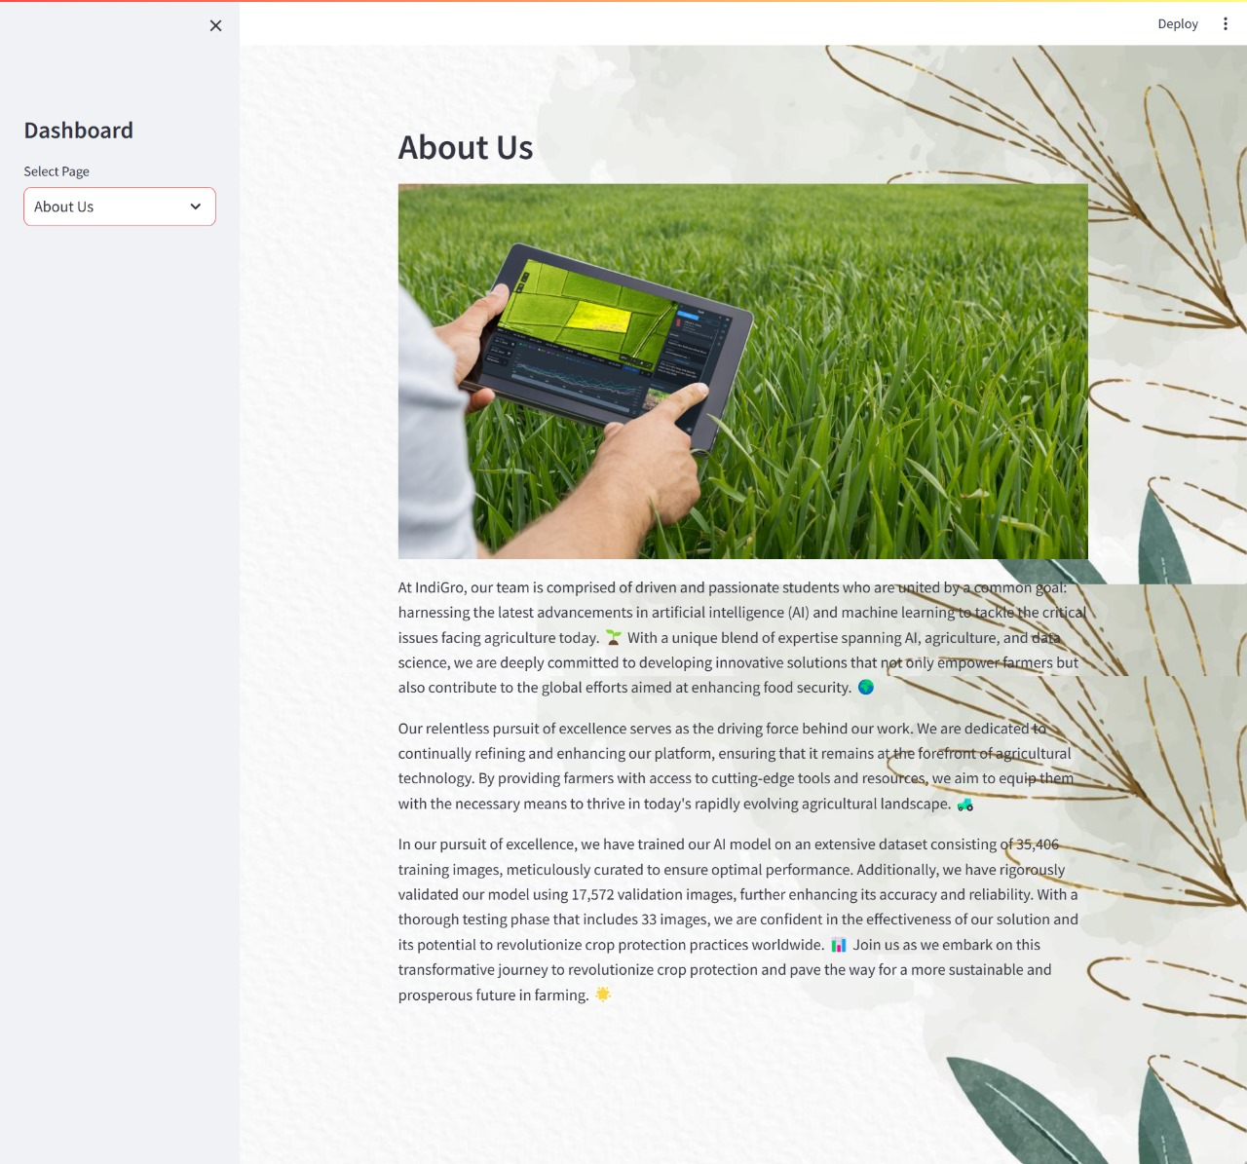
Dashboard Snapshots

Slide 10
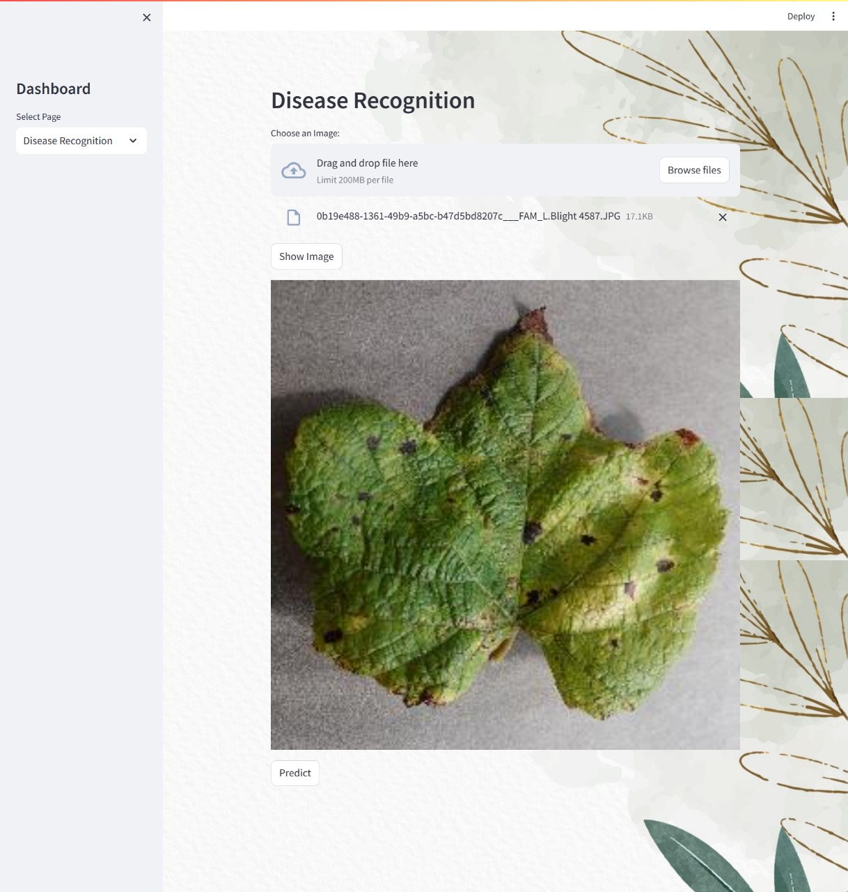
Dashboard Snapshots

Slide 11
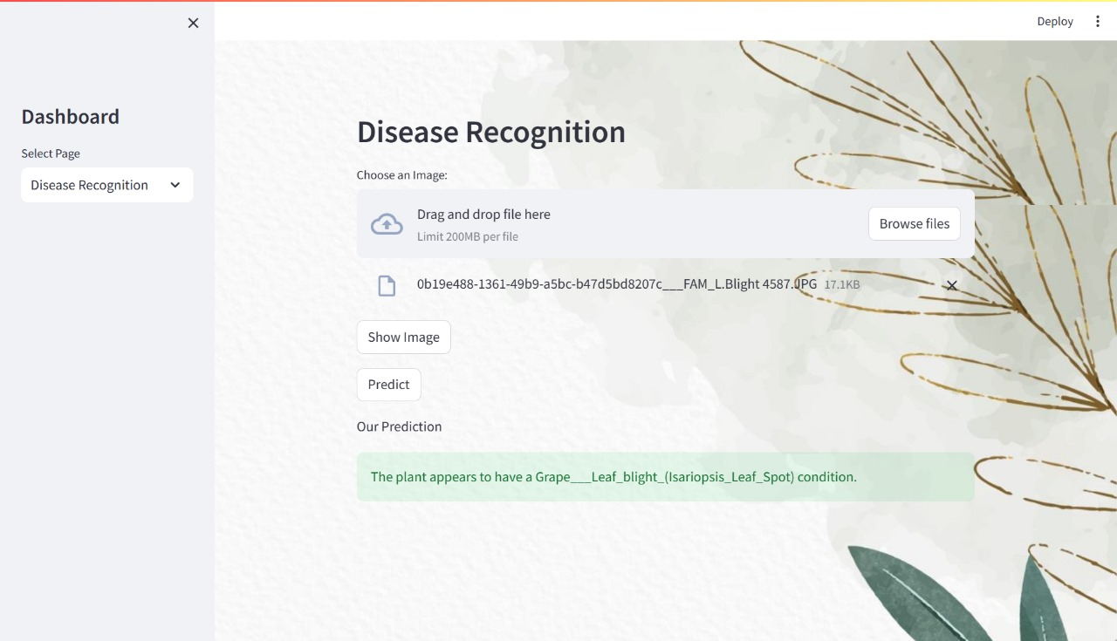
Dashboard Snapshots

Slide 12
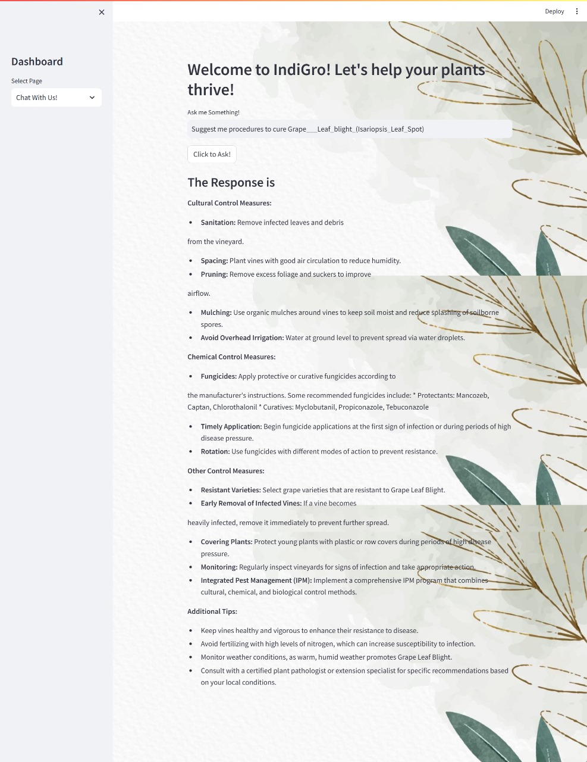
Dashboard Snapshots

Slide 13


Explore Our Project
GitHub Link:
jasneet-arora27/IndiGro-Predict-Prevent-Prosper (github.com)

Slide 14

References
Websites
YouTube: https://www.youtube.com/
Python Docs: https://www.python.org/
Pandas Docs: https://pandas.pydata.org/
Matplotlib Docs: https://matplotlib.org/
Seaborn Docs: https://seaborn.pydata.org/
Scikit-Learn Docs: https://scikit-learn.org/
TensorFlow Docs: https://www.tensorflow.org/
Keras Docs: https://keras.io/
OpenCV Docs: https://opencv.org/
Streamlit Docs: https://streamlit.io/
GitHub: https://github.com/

Slide 15

Some more References
Research Papers
Leaf Disease Detection Using Machine Learning:
https://www.researchgate.net/publication/344282301_Leaf_Disease_Detection_Using_Machine_Learning
Plant Disease Detection Using ML:
https://www.scribd.com/document/518098023/Project-Report
Dataset
New Plant Diseases Dataset: https://www.kaggle.com/datasets/vipoooool/new-plantdiseases-dataset

Slide 16


